Slide 1


STUDENT TRACKING SYSTEM IN HOSTEL
Presented By:
1.
Mohini Gawade
Aarti Lanke
Usha Dongre
Nisha Rodge
Kiran Tiwari mam
2.
3.
4.
Under Guidance of:

Slide 2
.
Aim of Project
Back-End Architecture
.
Content
ER - Diagram
Front-End Architecture
Technology Stack
Demo Screenshots
Project Features
Conclusion

Slide 3




AIM OF PROJECT
The Student Tracking system in hostel project aims to provide an efficient solution for managing hostel facilities, including student accommodations, room allocations, and administrative tasks.
It will streamline processes, enhance security, and improve the overall management of hostel operations.
HTML,CSS,JS
SpringBoot,Angular
My-SQL

Slide 4
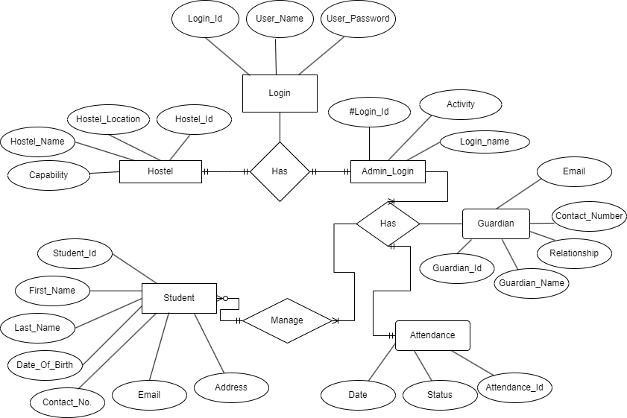
ER-DIAGRAM

Slide 5
Technology Stack
1
HTML
HTML (HyperText Markup Language) is the code that is used to structure a web page and its content..
2
CSS
CSS (Cascading Style Sheets) is used to style and layout web pages — for example, to alter the font, color, size and other decorative features.
3
ANGULAR
Angular is a platform and framework for building single-page client applications using HTML and TypeScript. Angular is written in TypeScript.
4
SPRINGBOOT & MYSQL
Spring boot and MySQL are commonly used together in building robust and scalable web applications

Slide 6
PROJECT FEATURES
Student Records
Admin
Attendance
Guardian Records

Slide 7
BACK-END ARCHITECTURE
1. Encapsulation:
2. Abstraction:
3. JPA Mappings:
4. MySQL (Database):
5. Spring Boot Framework :
6.Postman

Slide 8
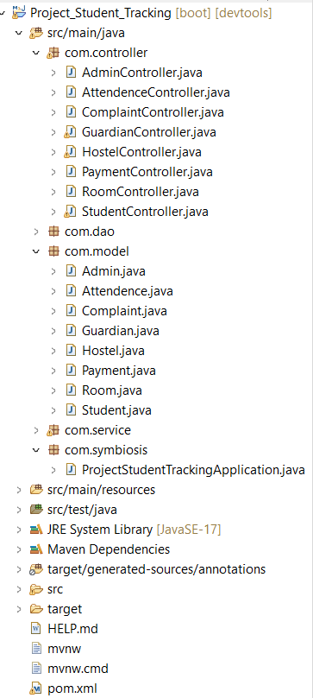
encapsulation
abstraction

Slide 9

postman
Postman is an API platform for building and using APIs.
HTTP Methods :-
PostMapping
PutMapping
GetMapping
DeleteMapping

Slide 10
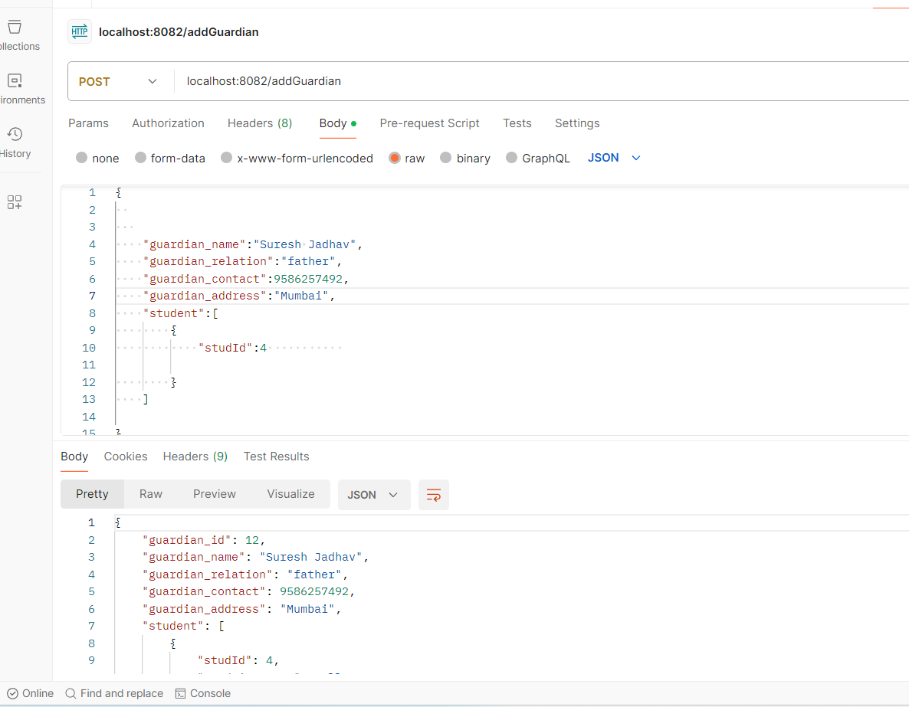
@postmaping
@Postmapping in spring mvc framework is a powerful tool for handling the http post requests in your restful web services.
@Postmapping annotation is a spring annotation that is used to map http post requests onto specific handler methods.

Slide 11
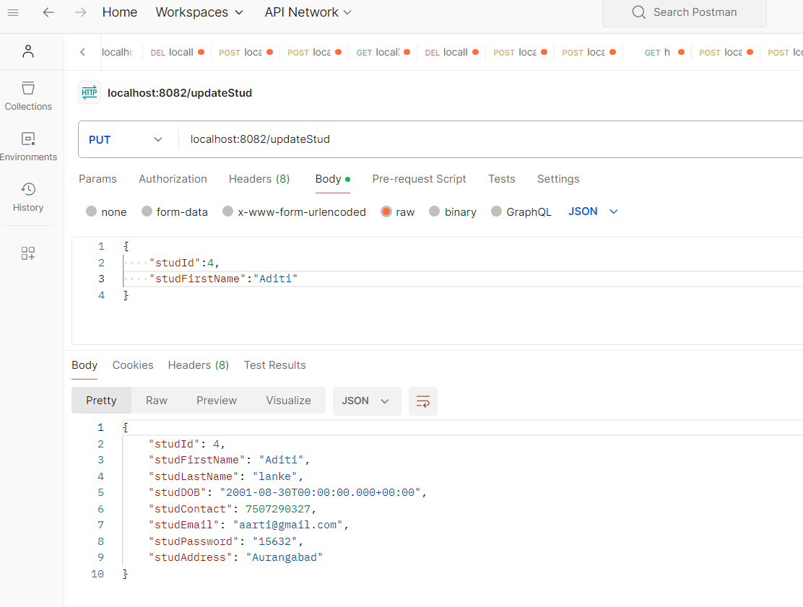
@putmapping
@Putmapping annotation in string MVC framework is a powerful tool for handling HTTP PUT requests in your restful web services.
@Putmaping annotation is a spring annotation that is used to map http put requests onto specific handler methods.

Slide 12
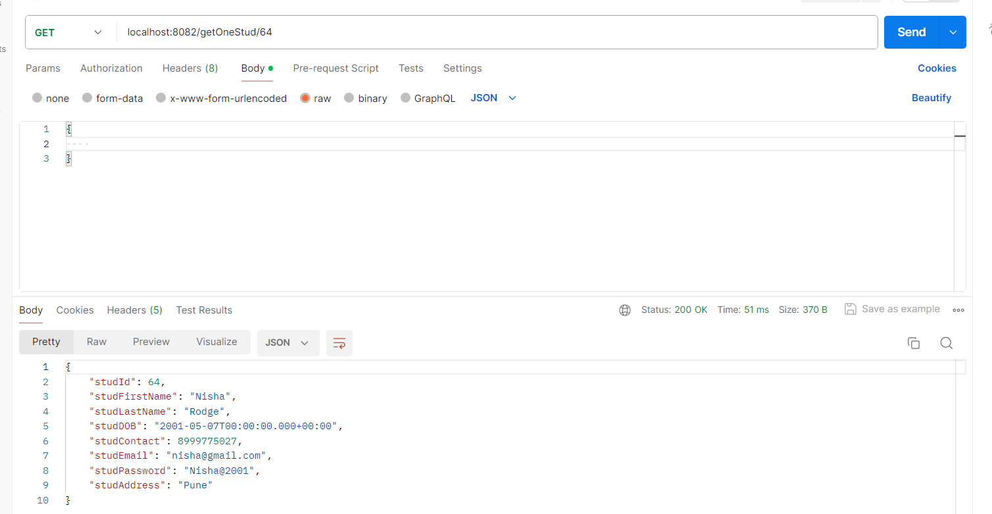
@getmapping
@GetMapping annotation we can easily define endpoints of RESTful API and handle various HTTP requests.
@GetMapping annotation is used for mapping HTTP GET requests onto specific handler methods.
- It is composed annotation that acts as a shortcut for @RequestMapping (method= RequestMethod. GET).

Slide 13
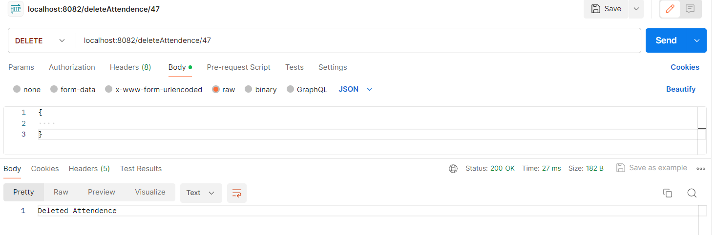
@deletemapping
- @DeleteMapping annotation is a Spring annotation that is used to map HTTP DELETE requests onto specific handler methods.
- @RequestMapping annotation with method = RequestMethod. DELETE attribute.

Slide 14
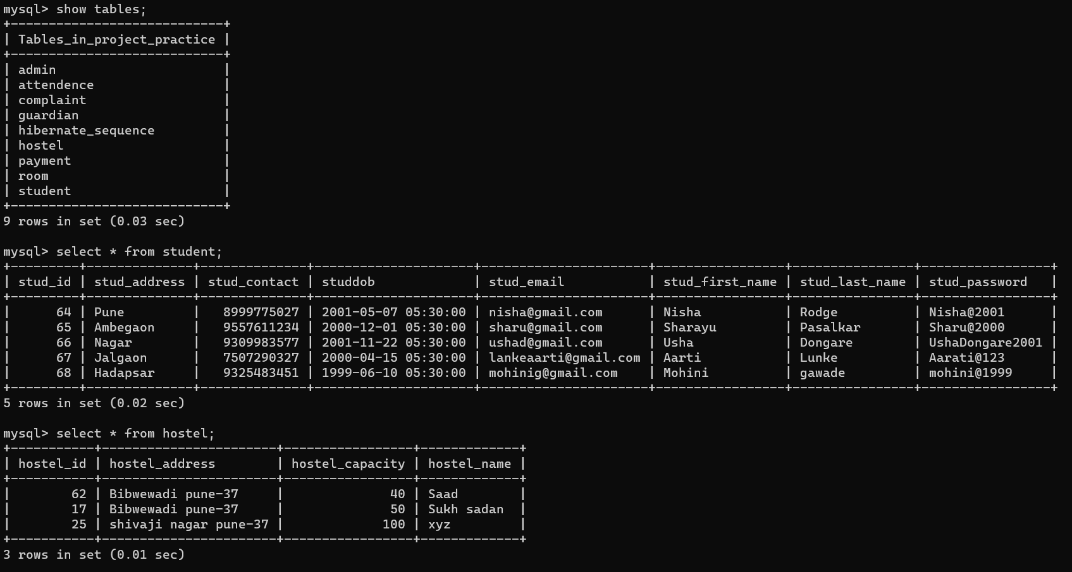
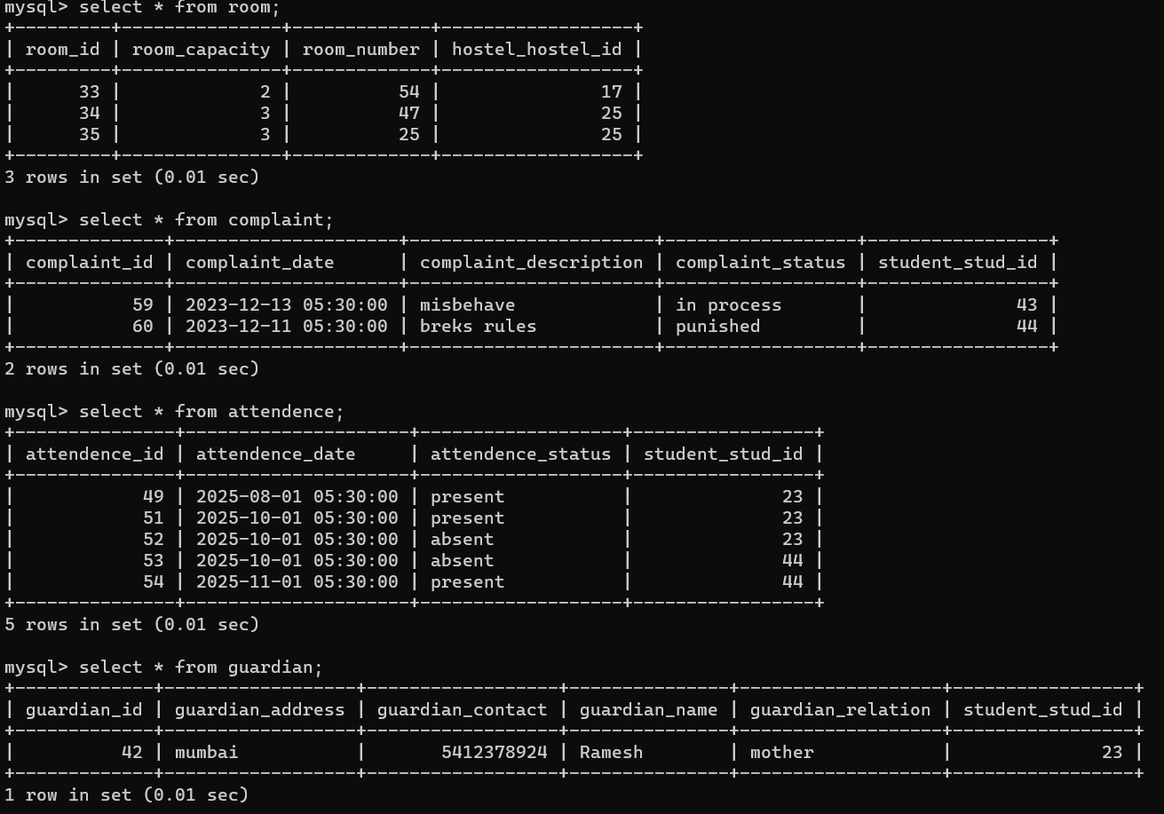
database of project

Slide 15
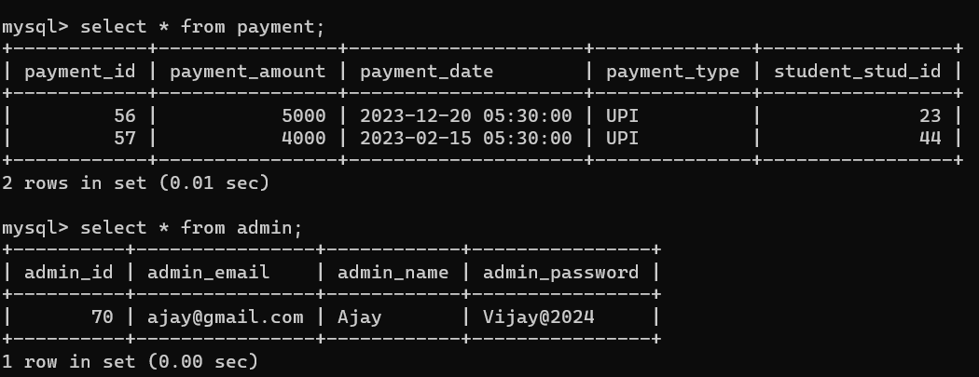

Slide 16
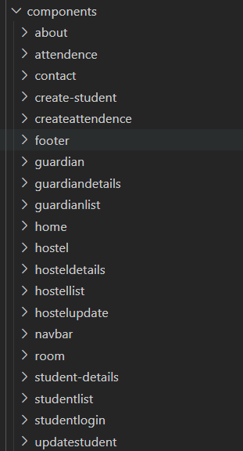
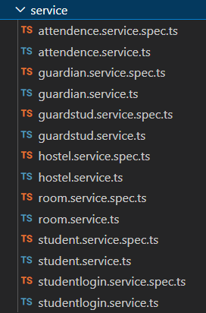
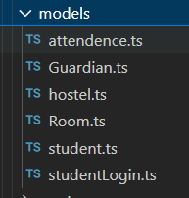
FRONT-END ARCHITECTURE

Slide 17
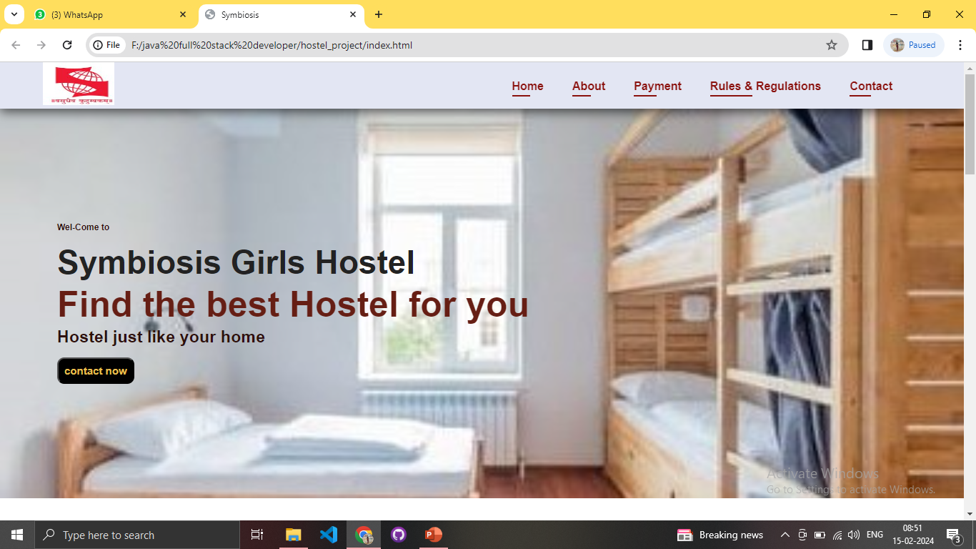
DEMO SCREENSHOTS

Slide 18
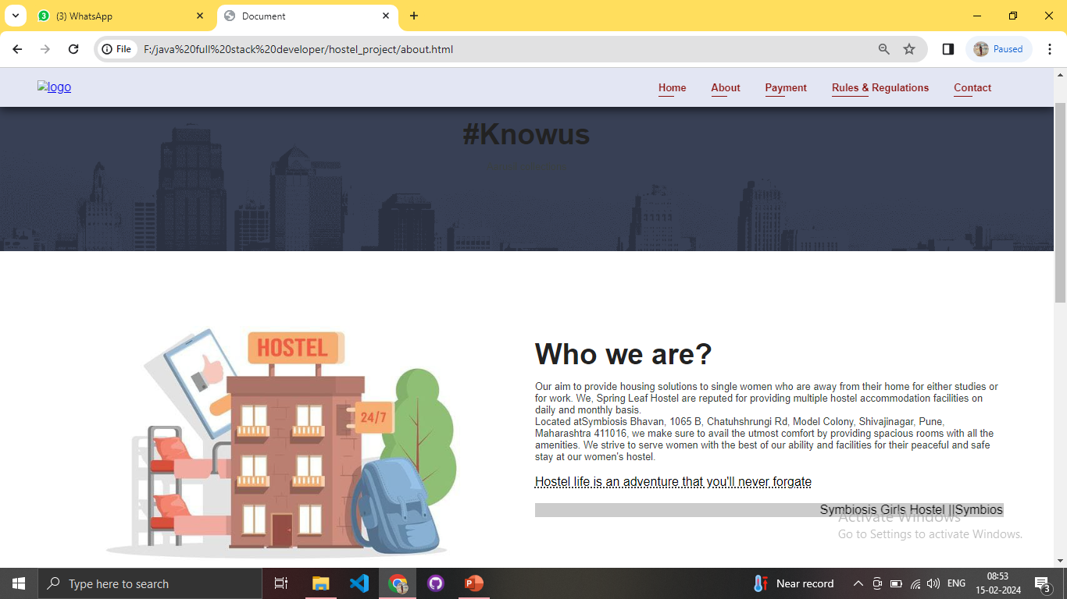
about us

Slide 19
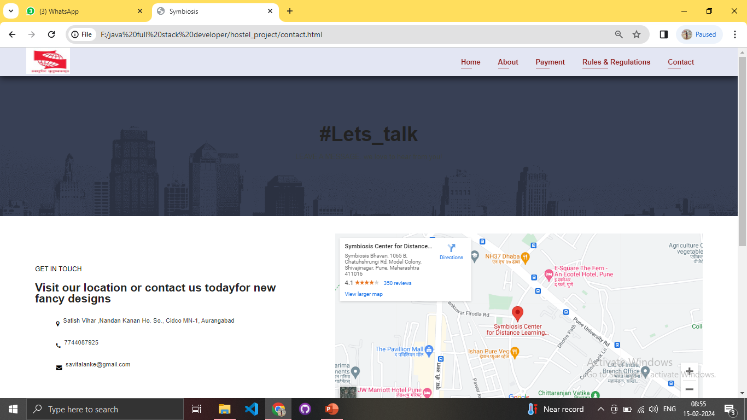
contact us

Slide 20
CONCLUSION
The best student tracking management system in hostel software is essential for any school hostel. It offers many benefits, including efficient communication, improved record-keeping, easy attendance tracking, effective room management, and enhanced security.

Slide 21
thank you

Slide 22


